Slide 1
SCTP MODULE 2 GROUP PROJECT
India Opportunity
Navigator
Evidence-linked opportunities for Singapore SMEs exploring India
Browse opportunities
Review evidence
Build a shortlist
Kelvin Lee and Jeffrey Kong
Lesson 2.19, 1 October 2026
Notes:
Presenter: Kelvin. Target: 20 seconds.
Introduce the app and the team. Explain that the project helps Singapore SMEs and market advisors explore evidence-linked India opportunities.

Slide 2
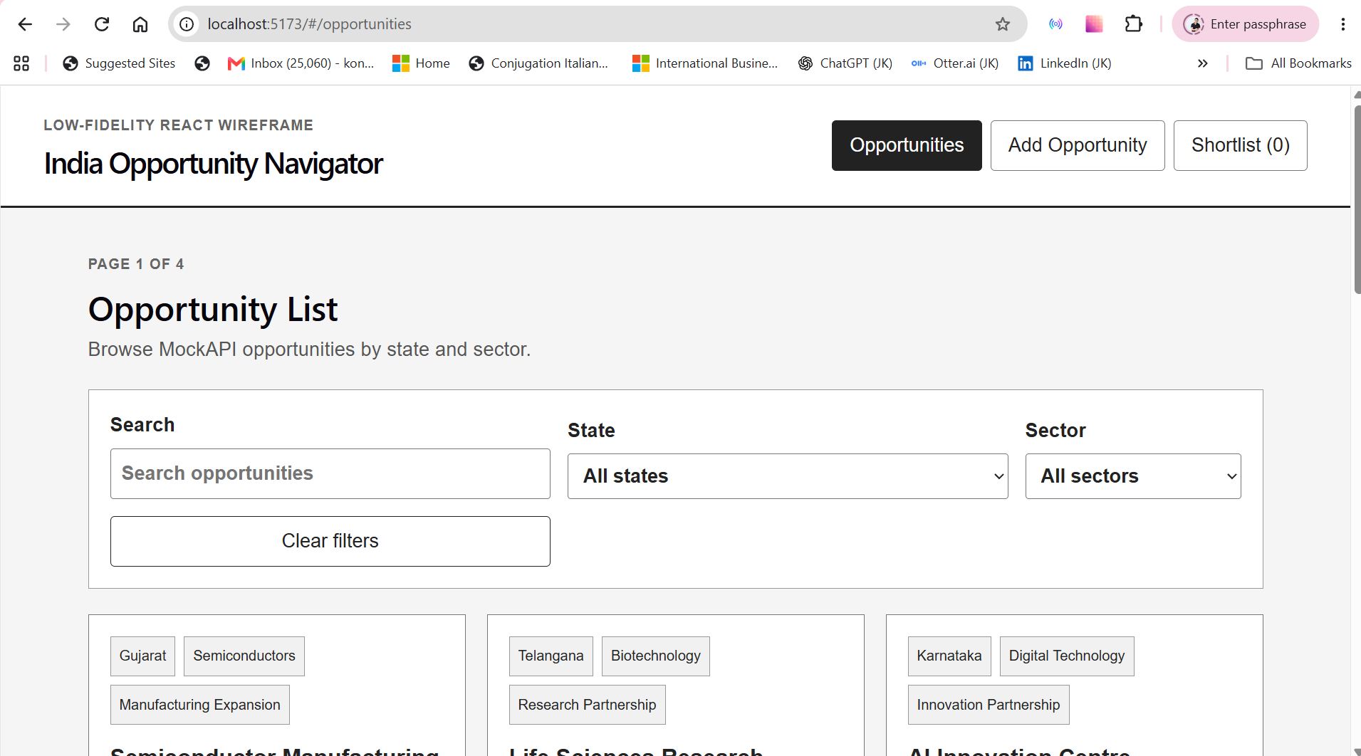
WHY WE BUILT IT
Problem and target users
India market information is spread across many sources. SMEs need a simpler way to compare opportunities before committing time and resources.
BUILT FOR
Singapore SMEs exploring India
Market advisors supporting internationalisation
International business teams
Notes:
Presenter: Kelvin. Target: 40 seconds.
Explain the problem first. Users often review disconnected sources before they can compare market opportunities.
Identify the users: Singapore SMEs, market advisors and international business teams.
Visual source: docs/screenshots/opportunity-list.png.

Slide 3
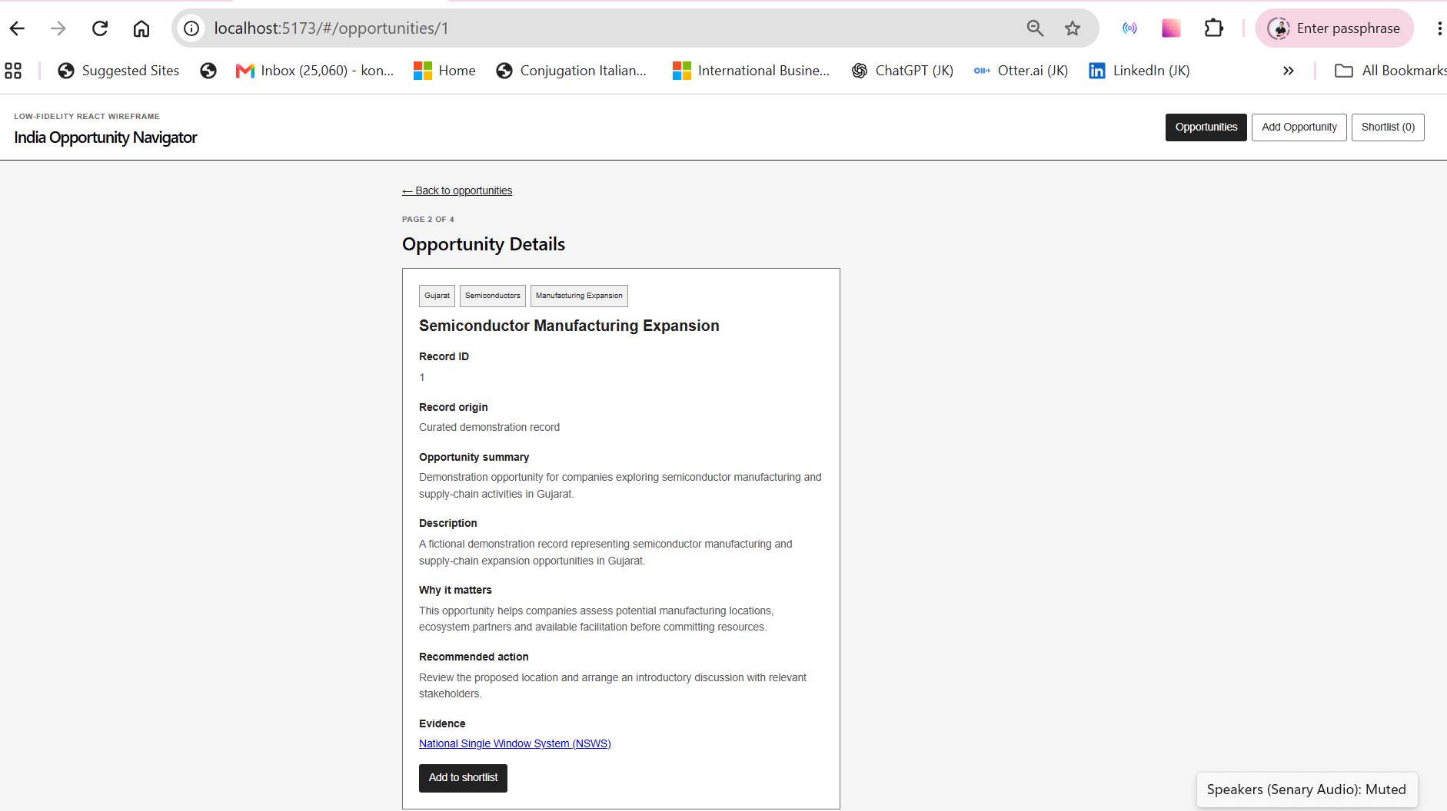
USER JOURNEY
From discovery to evidence
1
Explore
Search by keyword, state and sector.
2
Assess
Review the summary, rationale and recommended action.
3
Verify
Open the linked source before saving an opportunity.
Notes:
Presenter: Kelvin. Target: 45 seconds.
Walk through the decision journey: explore, assess and verify.
Point out that each record includes a rationale, recommended action and evidence link.
Visual source: docs/screenshots/opportunity-details.png.

Slide 4
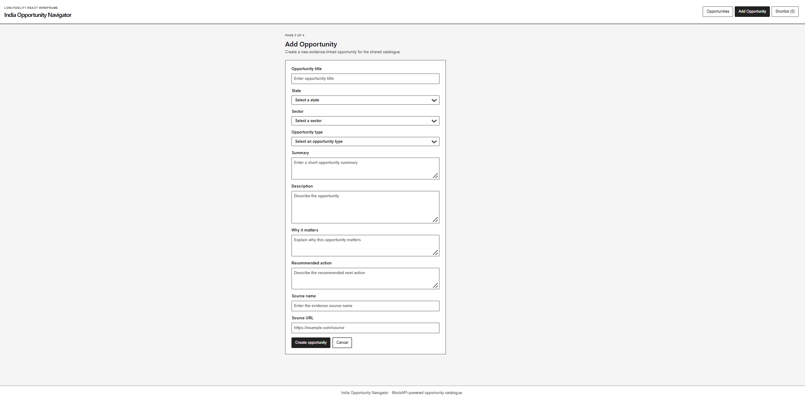
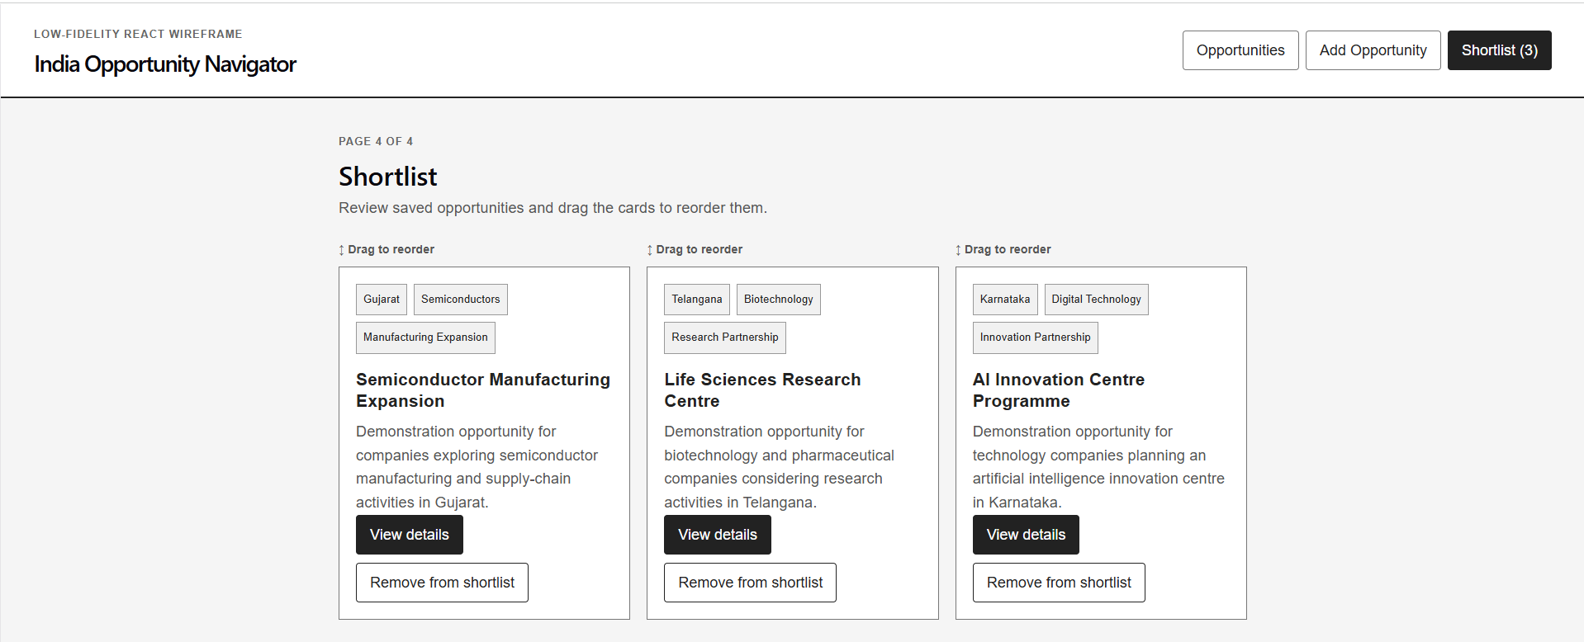
CREATE AND PRIORITISE
Main application features
Controlled form
Persistent shortlist
Creates and deletes MockAPI records
Native drag events reorder cards; localStorage retains the order
Notes:
Presenter: Jeffrey. Target: 40 seconds.
Explain that the form uses controlled inputs and creates a record through MockAPI.
Explain that the shortlist uses native browser drag events. localStorage preserves the card order after refresh.
Visual sources: docs/screenshots/add-opportunity.png and docs/screenshots/shortlist-drag-drop.png.

Slide 5
HOW THE PARTS CONNECT
Application architecture
NETLIFY
Public Vite build
REACT + VITE
Routes, components and state
MOCKAPI
LOCALSTORAGE
Shared 12-field opportunity records
Saved shortlist and card order
Notes:
Presenter: Jeffrey. Target: 60 seconds.
Netlify hosts the public Vite build. React Router connects the four application views.
React state controls the interface. MockAPI stores the shared records. localStorage preserves the shortlist and its order.

Slide 6
FROM LESSONS TO APPLICATION
React concepts applied
JSX and props
The project applies the React lessons through one complete user flow.
Reusable navigation, filters and opportunity cards
useState
Filters, form inputs, loading, errors and shortlist state
useEffect
Every team member can explain how these concepts support the live application.
Fetches records and persists shortlist order
React Router
Catalogue, details, form and shortlist routes
Conditional rendering
Loading, error and empty-result feedback
Notes:
Presenter: Jeffrey. Target: 60 seconds.
Link each concept to something the audience will see in the demo.
Emphasise that the team can explain the code rather than only showing the final interface.

Slide 7
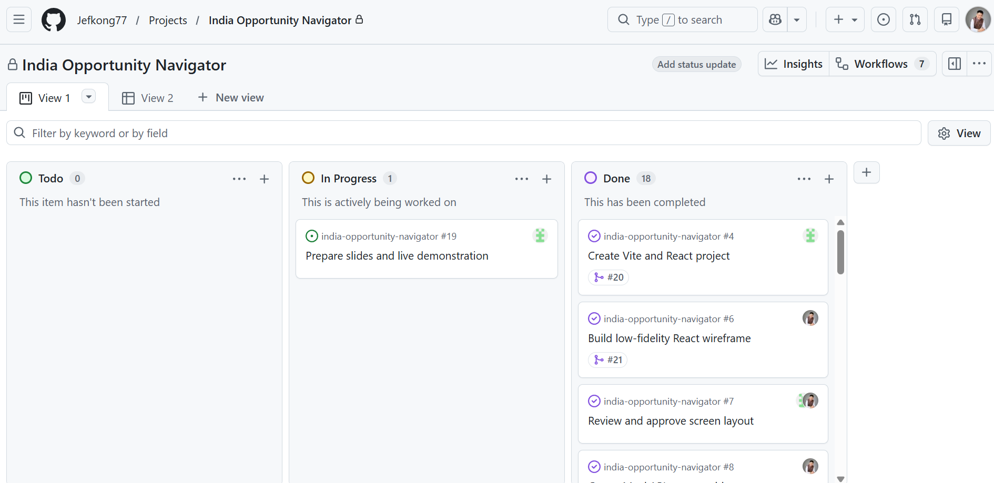
GITHUB EVIDENCE
Collaboration and quality checks
WORKFLOW
Issues, feature branches and pull requests
VERIFICATION
10 automated tests
Lint and production build
Browser and Netlify checks
VISIBLE PROGRESS
18 Issues completed; Issue #19 covers the final presentation
Notes:
Presenter: Jeffrey. Target: 50 seconds.
Show that work is divided and traceable through GitHub Issues, feature branches and pull requests.
Mention the 10 automated tests, lint, production build, browser checks and Netlify deployment.
Visual source: docs/screenshots/github-project-board.png.

Slide 8
PRESENTATION HANDOFF
Team learning and live demo
KELVIN
JEFFREY
Product and user journey
Integration and delivery
Problem, catalogue, filters, details and evidence
Form, shortlist, persistence, testing, deployment and documentation
LIVE DEMO
Kelvin ~3 min
Jeffrey ~4 min
Catalogue, filters, details and evidence
Create, shortlist, reorder, refresh and delete
Target: 13–14 minutes total
Backup: Netlify, local app and screenshots
Notes:
Presenters: Kelvin and Jeffrey. Target: 60 seconds for this slide.
Kelvin summarises learning about translating requirements into the user journey and working through GitHub.
Jeffrey summarises learning about state, integration, testing, deployment and documentation.
Move directly into the live demo. Keep the full presentation within 10 to 15 minutes.
Backup plan: use the local app with npm.cmd run dev, then screenshots if connectivity fails.

